Slide 1
ML Clustering Assignment

Slide 2
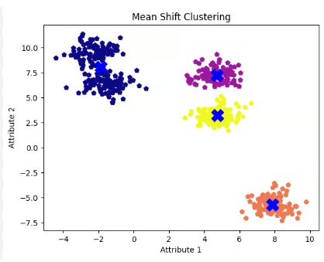
Mean Shift Clustering
Definition:
Mean shift is falling under the category of a clustering algorithm in contrast of Unsupervised learning that assigns the data points to the clusters iteratively by shifting points towards the mode (mode is the highest density of data points in the region, in the context of the Mean shift). As such, it is also known as the Mode-seeking algorithm. Mean-shift algorithm has applications in the field of image processing and computer vision.
Plot:
Python code:
from sklearn.cluster import MeanShift
clustering = MeanShift(bandwidth=2).fit(X)
Y_MS= clustering.fit_predict(X)

Slide 3
Advantages:
It can handle arbitrary data shapes and sizes.
It doesn’t require prior knowledge of the number of clusters.
It doesn’t make assumptions about the distribution of data points.
It can work well with noisy data
Disadvantages:
It is computationally expensive, especially for large datasets.
It is sensitive to the choice of bandwidth, which affects the cluster sizes and shapes.
It may converge to local optima instead of the global optimum.
Real time applications of Mean Shift clustering:
Image processing and image denoising,
motion tracking, Market segmentation,
Social network analysis, Search result grouping,
Medical imaging, Image segmentation and Anomaly detection.

Slide 4
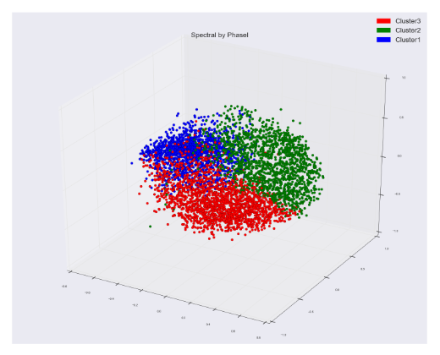
Spectral Clustering
Definition:
Spectral Clustering is a variant of the clustering algorithm that uses the connectivity between the data points to form the clustering.
It uses eigenvalues and eigenvectors of the data matrix to forecast the data into lower dimensions space to cluster the data points.
It is based on the idea of a graph representation of data where the data point are represented as nodes and the similarity
between the data points are represented by an edge.
Plot:
Python code:
from sklearn.cluster import SpectralClustering
SC = SpectralClustering(n_clusters=2, assign_labels=‘discretize’, random_state=0).fit(X)
Y_SC= SC.fit_predict(X)

Slide 5
Advantages:
Spectral clustering can effectively identify clusters of non-convex shapes, unlike traditional methods like k-means that are biased toward spherical clusters.
It does not make assumptions about the data distribution, making it suitable for a wide range of datasets.
It provides meaningful insights into the underlying graph structure of the data, often making it interpretable in the context of network analysis.
Disadvantages:
Computing eigenvalues and eigenvectors of large similarity matrices is computationally expensive, making spectral clustering impractical for very large datasets.
Poor construction of the similarity graph can lead to suboptimal clustering results, requiring careful preprocessing and parameter tuning.
In many practical applications, defining an appropriate similarity measure is non-trivial and may require significant domain expertise.
Real time applications of Spectral clustering:
statistics,
machine learning,
pattern recognition,
data mining and image processing.

Slide 6
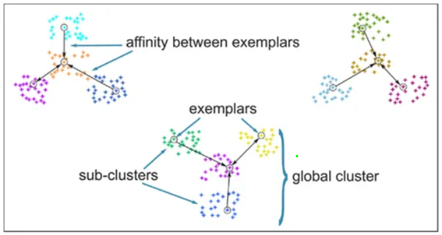
Affinity Propagation Clustering
Definition:
In statistics and data mining, affinity propagation (AP) is a clustering algorithm based on the concept of "message passing" between data points.
Unlike clustering algorithms such as k-means or k-medoids, affinity propagation does not require the number of clusters to be determined or estimated before running the algorithm.
Similar to k-medoids, affinity propagation finds "exemplars," members of the input set that are representative of clusters.
Plot:
Python code:
from sklearn.cluster import AffinityPropagation
aff = AffinityPropagation(random_state=5)
Y_aff= aff.fit_predict(X)

Slide 7
Advantages:
Automatic Determination of the Number of Clusters
AP works with any similarity measure, such as Euclidean distance, cosine similarity, or custom-defined metrics. This flexibility allows it to be applied to various data types and domains.
AP can efficiently handle large datasets when the similarity matrix is sparse, as it avoids the need to compute and store all pairwise similarities.
Disadvantages:
Computationally Intensive: It scales poorly with the size of the dataset, as it requires constructing and processing a similarity matrix.
Memory Usage: The similarity matrix can be memory-intensive for very large datasets.
Sensitive to Hyperparameters: The "preference" and "damping factor" parameters require tuning, and different settings can lead to significantly different results.
Real time applications of Affinity Propagation clustering:
Image processing: For grouping similar image patches or super pixels.
Bioinformatics: Identifying gene families, protein functions, or structural clusters.
Recommender systems: Finding groups of users or items with similar preferences.
Social network analysis: Detecting communities or clusters of individuals

Slide 8
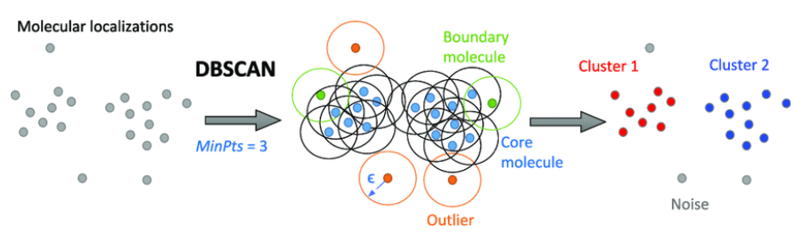
DBSCAN Clustering
Definition:
DBSCAN (Density-Based Spatial Clustering of Applications with Noise) is a popular clustering algorithm in machine learning that identifies clusters based on the density of points in a dataset. Unlike other clustering algorithms like K-Means, DBSCAN does not require specifying the number of clusters in advance and is effective at identifying clusters of arbitrary shape, as well as handling noise (outliers).
Plot:
Python code:
from sklearn.cluster import DBSCAN
DB = DBSCAN(eps=3, min_samples=2).fit(X)
Y_DB= DB.fit_predict(X)

Slide 9
Advantages:
Noise Detection: Effectively identifies outliers or anomalies in real-time streams.
No Assumption of Cluster Shape: Suitable for non-linear or arbitrarily shaped clusters.
Efficient for Large Datasets: With optimizations, it can handle real-time data flows.
Disadvantages:
Epsilon (ϵ\epsilonϵ): The choice of the neighborhood radius (ϵ\epsilonϵ) is critical and can significantly affect the clustering results. A poorly chosen value can lead to over-clustering or under-clustering.
DBSCAN is best suited for datasets with well-separated clusters of similar density. It may fail to detect clusters that are elongated, have complex shapes, or are connected by sparse regions.
While DBSCAN is good at identifying noise, it can sometimes classify outliers incorrectly if the parameters are not well-tuned.
Real time applications of DBSCAN clustering:
Image Processing and Computer Vision, Customer Segmentation,
Transportation and Traffic Analysis, Environmental Monitoring,
Social Network Analysis, Healthcare and Bioinformatics,
Astronomy and Astrophysics, Retail and Inventory Management and Geospatial Analysis

Slide 10
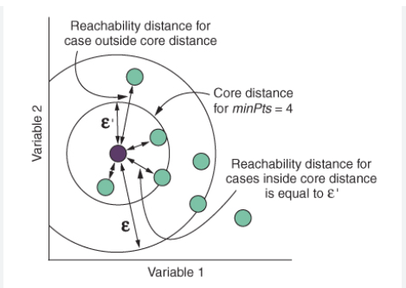
OPTICS Clustering
Definition:
OPTICS (Ordering Points To Identify the Clustering Structure) is a density-based clustering algorithm used in machine learning. It is particularly well-suited for discovering clusters of varying shapes, sizes, and densities in a dataset. OPTICS is an extension of the DBSCAN (Density-Based Spatial Clustering of Applications with Noise) algorithm, designed to address its limitations when dealing with datasets containing clusters of varying densities.
Plot:
Python code:
from sklearn.cluster import OPTICS
OP = OPTICS(min_samples=2).fit(X)
Y_OP= OP.fit_predict(X)

Slide 11
Advantages:
OPTICS can identify clusters of varying densities, unlike DBSCAN, which requires a single density parameter (ϵ\epsilonϵ) for all clusters.
It produces a reachability plot, which provides insights into the hierarchical structure of clusters, allowing the user to select clustering thresholds dynamically.
Like DBSCAN, OPTICS effectively identifies outliers as noise points.
OPTICS does not require user to specify the number of clusters beforehand, unlike k-means.
Disadvantages:
Storing the distance matrix for large datasets can be memory-intensive, potentially limiting scalability.
For datasets with sparse or highly scattered points, OPTICS can struggle to identify meaningful clusters.
The reachability plot, while informative, can be challenging to interpret for large or complex datasets, especially when the structure is ambiguous.
While OPTICS is less sensitive to the eps parameter than DBSCAN, it still depends on the minimum number of points (MinPts) parameter. Choosing the wrong value can significantly affect the results.
Real time applications for OPTICS clustering:
Urban planning: Identifying densely populated areas and their boundaries.
Environmental monitoring: Tracking patterns of pollution, vegetation, or wildlife activity.
Traffic management: Detecting congestion patterns or areas with high vehicle density.
Fraud detection: Identifying irregularities in transaction patterns.
Network security: Spotting unusual patterns in network traffic that might indicate cyberattacks.
Industrial monitoring: Detecting anomalies in sensor data from machinery or equipment.

Slide 12
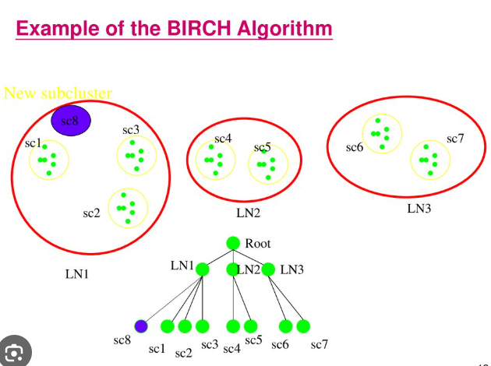
BIRCH Clustering
Definition:
BIRCH (Balanced Iterative Reducing and Clustering using Hierarchies) is a clustering algorithm that is designed to handle large datasets efficiently. It is particularly useful when dealing with data that cannot fit into memory or when performing clustering on large datasets with millions of data points.
Plot:
Python code:
from sklearn.cluster import Birch
brc = Birch(n_clusters=None)
Y_brc= brc.fit_predict(X)

Slide 13
Advantages:
BIRCH is highly efficient and scalable for large datasets. It has a time complexity of O(n), making it faster than many other clustering algorithms like k-means, especially when dealing with very large datasets.
BIRCH is an incremental clustering algorithm, meaning it can handle the addition of new data points without needing to recompute the entire clustering from scratch.
BIRCH can be used as a pre-processing step for other clustering algorithms
Disadvantages:
Sensitivity to the number of clusters.
Not suitable for high-dimensional data
Requires preprocessing
The compact summary structure used in the algorithm (CF tree) can also consume a lot of memory for large datasets.
The algorithm may have difficulty distinguishing between clusters of varying densities, particularly if the density of the clusters varies significantly.
Real time applications for BIRCH clustering:
Financial Market Prediction
Real-Time Recommendation Systems
Healthcare and Patient Monitoring
Sensor Data Analysis in IoT Applications
Real-Time Traffic Monitoring and Smart Cities

